Slide 1










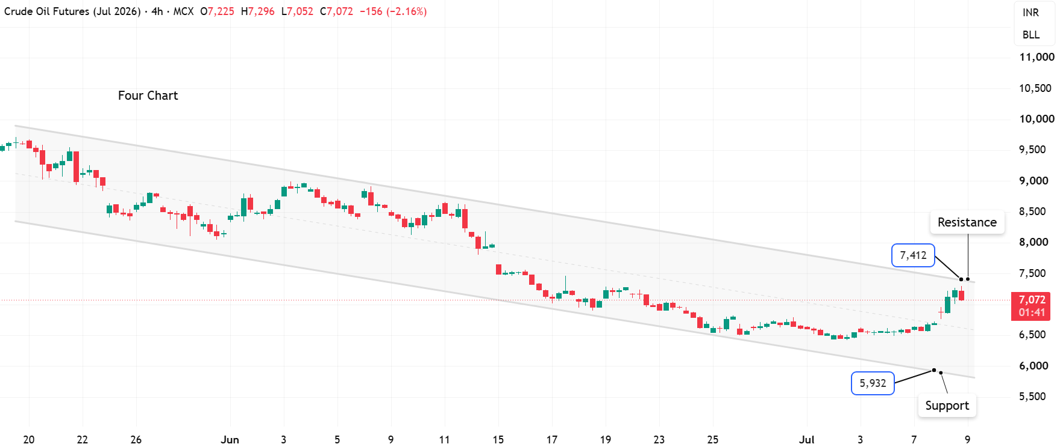
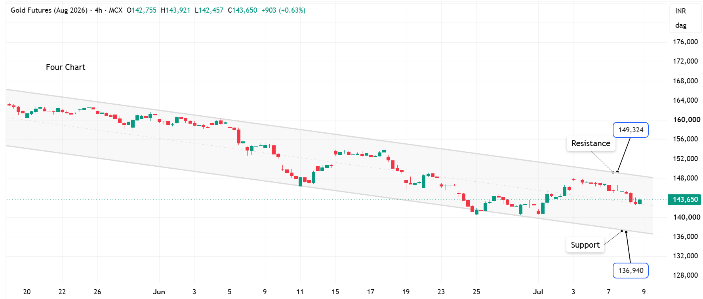

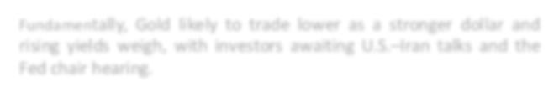




resistance
Commodity Market Update – 09th july 2026
Gold turns bearish | Crude prices are likely to trade bullish
Intraday Trend
Crude Oil
Crude Oil
Gold
Silver
Natural Gas
Silver
Gold
Intraday Trend: Bullish
Intraday Trend: Bearish
Key Levels: 6600- 6800 (Support) and 7300 - 7500 (Resistance)
Key Levels: 138000 - 140000 (Support) and 146000 - 148000 (Resistance)
Fundamentally, Oil prices climbed after fresh U.S. strikes on Iran dimmed hopes for peace and full reopening of the Strait of Hormuz, a key oil chokepoint.
Fundamentally Gold prices eased after a one-week low as renewed Iran war concerns and Trump's comments fueled inflation fears, raising interest-rate expectations.

Slide 2

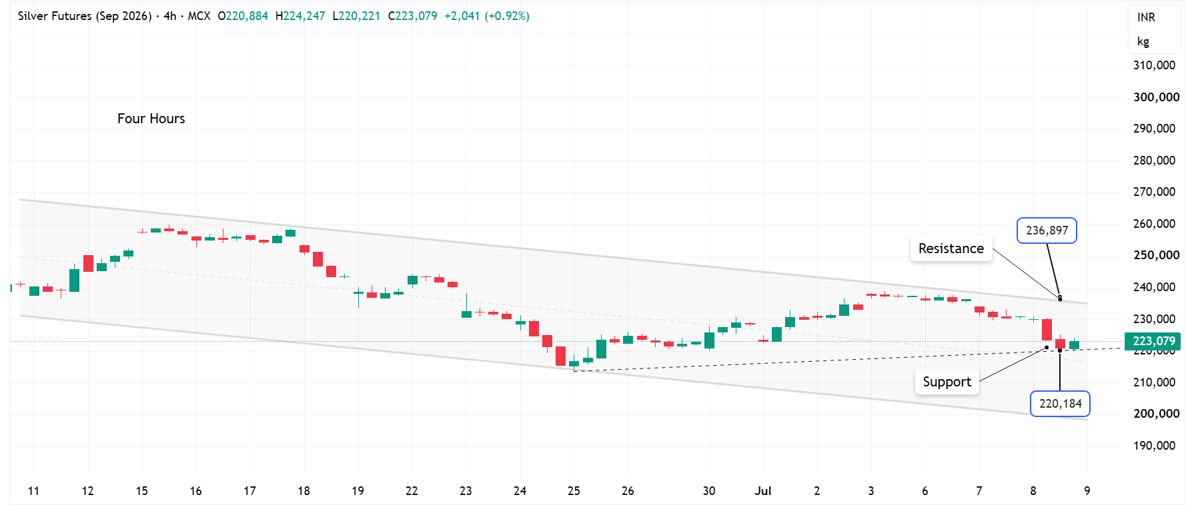
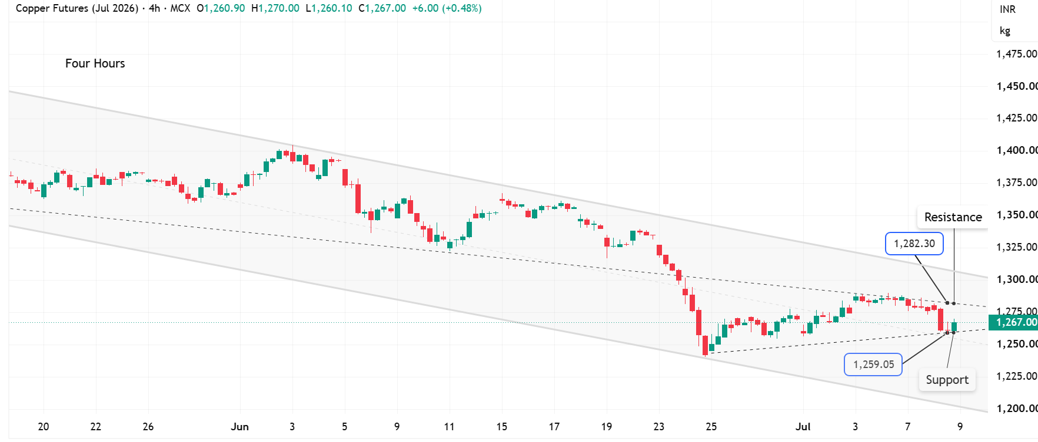
Commodity Market Update – 09th July 2026
Silver turns bearish | Copper prices are likely to trade lower
Intraday Trend
Crude Oil
Silver
Gold
Silver
Natural Gas
Copper
Intraday Trend: Bearish
lntraday Trend: Bearish
Key Levels: 217000- 220000 (Support) and 227000- 231000(Resistance)
Key Levels: 1240 – 1255 (Support) and 1280 - 1292(Resistance)
Fundamentally,Silver holds last week’s gains as weak U.S. jobs data and lower oil prices reduce expectations of Fed rate hikes, supporting precious metal demand.
Fundamentally, Copper rises in early Asia trade as weak U.S. June payroll data boosts expectations of delayed Fed tightening, supporting demand for metals.
.
.

Slide 3
Commodity Market Update – 09th July 2026
Trends, Support & Resistance
Percious Metals
Commodity | Unit | Contract | Trend | S2 | S1 | LTP | R1 | R2
MCXBULLDEX | $/oz | July | Down | 32800 | 33200 | 34002 | 35000 | 35400
GOLD | Rs/gms | Aug | Down | 138000 | 140000 | 143711 | 146000 | 148000
Gold $ | $/oz |  | Down | 3900 | 3980 | 4076 | 4160 | 4270
Silver | Rs/gms | Sep | Down | 217000 | 220000 | 223437 | 227000 | 231000
Silver $ | Spot |  | Down | 54.00 | 56.00 | 58.32 | 61.00 | 64.00
Base Metals
COPPER | MCX | July | Down | 1240 | 1255 | 1268.15 | 1280 | 1292
Zinc | MCX | July | Down | 360 | 364 | 368.80 | 373 | 378
Lead | MCX | July | Down | 189 | 194 | 199.05 | 204 | 209
Aluminium | MCX | July | Down | 329 | 333 | 337.45 | 342 | 346
Nickel | MCX | July | Down | 1450 | 1500 | 1567.40 | 1650 | 1700
Energy
ELECDMBL | MCX | July | Down | 3950 | 4040 | 4115 | 4300 | 4400
CRUDEOIL | NSE | July | Up | 6600 | 6800 | 7073 | 7300 | 7500
Nymex Crude $ | NYMEX |  | Up | 70 | 72 | 74.50 | 77 | 79
Brent Crude $ | ICE |  | Up | 75 | 77 | 79.00 | 81 | 83
NATURALGAS | MCX | July | Up | 290 | 299 | 307.80 | 322 | 330
Crudeoil NSE CMD | NSECMD | July | Up | 6600 | 6800 | 7075 | 7300 | 7500
Precious Metals
Base Metals
1250
338
192
36

Slide 4
Disclaimer
SEBI (Research Analyst) Regulations, 2014 vide registration number: INH000000164
Prathamesh Mallya
Manish Kumar Pargi
DVP Research - Commodities
Sr. Analyst – Technical & Derivatives
Prathamesh.Mallya@angelone.in
Manishkumar.Pargi@angelone.in
Tejas Anil Shigrekar Sr. Analyst – Technical & Derivatives Tejas.Shigrekar@angelone.in
We Research Analysts, authors and the names subscribed to this report, hereby certify that all of the views expressed in this research report accurately reflect our views about the
subject issuer(s) or securities. We also certify that no part of our compensation was, is, or will be directly or indirectly related to the specific recommendation(s) or view(s) in this
report. It is also confirmed that above mentioned Analysts of this report have not received any compensation from the companies mentioned in the report in the preceding twelve
months and do not serve as an officer, director or employee of the companies mentioned in the report.
Website: www.angelone.in
For Fundamental & Technical Queries E- mail: aolresearch@angelone.in

Slide 5
Disclaimer
We, Angel One Limited (hereinafter referred to as “Angel”) a company duly incorporated under the provisions of the Companies Act, 1956 with its registered office at 601, 6th Floor, Ackruti Star, Central Road, MIDC, Andheri East, Mumbai –
400093, CIN: (L67120MH1996PLC101709) and duly registered as a member of National Stock Exchange of India Limited, Bombay Stock Exchange Limited, Metropolitan Stock Exchange Limited, Multi Commodity Exchange of India Ltd and
National Commodity & Derivatives Exchange Ltd. Angel One limited is a company engaged in diversified financial services business including securities broking, DP services, distribution of Mutual Fund products. It is also registered as a
Depository Participant with CDSL and Portfolio Manager and Investment Adviser with SEBI. It also has registration with AMFI as a Mutual Fund Distributor. Angel One Limited is a registered entity with SEBI for Research Analyst in terms of SEBI
(Research Analyst) Regulations, 2014 vide registration number INH000000164 and also registered with PFRDA as PoP ,Registration No.19092018. Angel One Limited (formerly known as Angel Broking Limited) is the ultimate parent company of
the Group. Angel or its associates has not been debarred/ suspended by SEBI or any other regulatory authority for accessing /dealing in securities Market.
We hereby declare that our activities were neither suspended nor we have defaulted with any stock exchange authority with who m we are registered. However, SEBI, Exchanges, Clearing Corporations and Depositories etc have conducted the
routine inspection and based on their observations have issued advise/warning/show cause notices/deficiency l ett er s/ or levied penalty or for certain deviations observed in inspections or in normal course of business, as a Stock Broker /
Depository Participant.
AO L was merged with A ngel Global Capital Private Limited and subsequently name of Angel Global Capital Private Limited was ch anged to Angel Broking Private Limited (AO L) pursuant to scheme of Amalgamation sanctioned by the Hon'ble
High Court of Judicature at Bombay by Orders passed in Company Petition No 710 of 2011 and the approval granted by the Registrar of Companies. Further, name of Angel Broking Private Limited again got changed to Ang el Broking Limited
(AOL) pursuant to fresh certificate of incorporation issued by Registrar of Companies (ROC) dated June 28, 2018. Further name of Angel Broking name changed to Angel One Ltd pursuant to fresh certificate of incorporation issued by Registrar
of Companies (ROC) dated 23-09-21.
In case of any grievances please write to: support@angelone.in, Compliance O fficer Details: Name : Bineet Jha, Tel No. –08657864228, Email id - compliance@angelone.in
Registration granted by SEBI and certification from NISM in no way guarantee performance of the intermediary or provide any assurance of returns to investors.
This document is solely for the personal information of the recipient, and must not be singularly used as the basis of any in vestment decision. Nothing in this document should be construed as investment or financial advice. Each recipient of
this document should make such investigations as they deem necessary to arrive at an independent evaluation of an investment in the invest of the companies referred to in this document (including the merits and risks involved), and should
consult their own advisors to determine the merits and risks of such an investment
This report is not directed or intended for distribution to, or use by, any person or entity who is a citizen or resident of or located in any locality, state, country or other jurisdiction, where such distribution, publication, availability or use
would be contrary to law, regulation or which would subject Angel and its associates to any registration or licensing requirement within such jurisdiction. Angel or its associates or research analyst or his relative may have actual/beneficial
ownership of 1% or more in the securities of the subject company at the end of the month immediately preceding the date of publication of the research report. Neither Angel or its associates nor Research Analysts or his relative has any
material conflict of interest at the time of publication of research report.
Angel or its associates or research analyst or his relative may have actual/beneficial ownership of 1% or more in the securities of the subject company at the end of the month immediately preceding the date of publication of the research
report. Neither Angel or its associates nor Research Analysts or his relative has any material conflict of interest at the time of publication of research report.
Angel or its associates might have received any compensation from the companies mentioned in the report during the period preceding twelve months from the date of this report for services in respect of managing or co-managing public
offerings, corporate finance, investment banking or merchant banking, brokerage services or other advisory service in a merger or specific transaction in the normal course of business. Angel or its associates did not receive any compensation
or other benefits from the companies mentioned in the report or third party in connection with the research report. Neither research entity nor research analyst has been engaged in market making activity for the subject company.
Subject company(ies) may have been client during twelve mont hs preceding the date of distribution of the research report.
Reports based on technical and derivative analysis center on studying charts of a stock's price movement, outstanding positions and trading volume, as opposed to focusing on a company's fundamentals and, as such, may not match with a
report on a company's fundamentals. Investors are advised to refer the Fundamental and Technical Research Reports available on our website to evaluate the contrary view, if any.

Slide 6
The information in this document has been printed on the basis of publicly available information, internal data and other reliable sources believed to be true, but we do not represent that it is accurate or complete a nd it should not be relied on
as such, as this document is for general guidance only. Angel One Limited or any of its affiliates/ group companies shall not be in any way responsible for any loss or damage that may arise to any person from any inadvertent error in the
information contained in this report. Angel One Limited does not warrant the accuracy, adequacy or completeness of the service, information and materials and expressly disclaims liability for errors or omissions in the service, information
and materials. While Angel One Limited endeavours to update on a reasonable basis the information discussed in this material, there may be regulatory, compliance, or other reasons that prevent us from doing so.
Source of information: NSEINDIA.COM, Angel One.
This document is being supplied to you solely for your information, and its contents, information or data may not be reproduced, redistributed or passed on, directly or indirectly.
By referring to any particular sector, Angel does not provide any promise or assurance of favourable view for a particular industry or sector or business group in any manner. The investor is requested to take into consideration all the risk
factors including their financial condition, suitability to risk return profile and take professional advice before investing. Such representations are not indicative of future results.
"A graph of daily closing prices of securities is available at NSE and Economic Times. Choose a company fr om the list on the browser and select the "t hr ee years" icon in the price chart.“
Our research should not be considered as an advertisement or advice, professional or otherwise. The investor is requested to take into consideration all the risk factors including their financial condition, suitability to risk return profile a nd the
like and take professional advice before investing.
Our research should not be considered as an advertisement or advice, professional or otherwise. The investor is requested to take into consideration all the risk factors including their financial condition, suitability to risk return profile a nd the
like and take professional advice before investing.
Neither Angel One Limited, nor its directors, employees or affiliates shall be liable for any loss or damage that may arise from or in connection with the use of this information. Angel or its associates or Research Analyst or his relative might
have financial interest in the subject company. Research analyst has not served as an officer, director or employee of the subject company.
Investment in securities market are subject to market risks. Read all the related documents carefully before investing.
Any communication sent to clients on phone numbers or e-mail ids registered with the Trading Member is meant for client consumption and such material should not be redistributed.
Brokerage will not exceed SEBI prescribed limit.
Any Information provided by us through any medium based on our research or that of our affiliates or third parties or other external sources is subject to domestic and international market conditions a nd we do not guarantee the availability or
otherwise of any securities or other instruments and such Information is merely an estimation of certain investments, and we have not and shall not be deemed to have assumed any responsibility for any such Information.
You should seek independent professional advice and/or tax advice regarding the suitability of any investment decision whether based on any Information provided by us through the Site from inhouse research or third party reports or
otherwise.
The report and information contained herein is strictly confidential and meant solely for the selected recipient and may not be altered in any way, transmitted to, copied or distributed, in part or in whole, to a ny other person or to the media or
reproduced in any form, without prior written consent.

